Slide 1

A Presentation on Project Stage -I
Smart Building
Under the guidance of
Prof. Maithili Andhare
Sponsored by Dr. Rahul Mapari
Sourabh Upare (71923867G)
Tejveer Anand (71923874K)
Siddhant Jain( 71923718B)
PCET’S PIMPRI CHINCHWAD COLLEGE OF ENGINEERING AND RESEARCH,
Laxmi Nagar, Ravet, PUNE - 412 101.
ACADEMIC YEAR :2021-22

Slide 2
Outline of Presentation
Content
Introduction
Literature Survey
Gap Identification
Aim/ Problem Statement
Objectives
Methodology
Component Selection and Costing
Advantages & Disadvantages
Conclusion
References

Slide 3
Introduction
There is an increasing interest in using IoT devices for making buildings smarter and efficient. For instance, a significant amount of energy is being consumed by buildings. The need for energy efficiency in buildings is critical, and one of the objectives of a “smart building” is to monitor, reduce and manage building energy consumption without compromising the occupant comfort and operational efficiency.
Hence, smart buildings can employ different types of IoT sensors in mechanical systems which make these systems more intelligent. A huge amount of data is generated from the embedded IoT sensors and their associated controllers mounted within the smart buildings. This IoT enabled smart building data can be extracted, filtered, analyzed and used for smart building analytics.
It is clear that there is a growing interest in smart buildings and data management and analytics. However, there is a dire need to identify the challenges as well as the solutions to overcome those challenges in this domain.

Slide 4

Literature Review
Sr. No. | Authors and Year of Publication | Journal Name | Methodology Used | Advantages | Limitations/ Drawbacks
1 | Olivier Debauche and Yahya Moussaoui, IEEE 2020 | Internet of Things Learning: A practical Case for Smart Building automation. | This paper proposes a data powered vision based on cloud that will allow the user the ability to analyze data effectively. | Fast process of data transmission and reception. | Sometimes response of the process is slow in real time due to bid chunks of data input which creates a time lag.
2 | Anirudh Ramasami and Surya Varanasi, IRJET 2019. | Smart Building Automation using Internet of Things | This paper proposes a prospective over Smart Building and its utilities. | Efficient use of resources for enhancing the energy conservation | Initial investment is high.

Slide 5
Gap Identification / Finding from Survey
From the literature survey following gaps are identified :
Analysis of the data for IoT enabled smart buildings is a major concern as the information is scattered as needs to ordered and collected effectively.
From decades, electricity wastage has been a major concern for all which needs to be addressed using the new technologies like Cloud instead of physical Servers.

Slide 6
Problem Statement
Aim :
“To monitor, reduce and manage building energy consumption without compromising the occupant comfort and operational efficiency”

Slide 7
Objectives
The objectives of the proposed projects are :
Control lights using motion sensors.
Measure energy consumption.
Real time analysis of data on monitor.

Slide 8
MQTT BROKER
SQL
DATABASE
PIR motion sensor
NodeMCU
Microcontroller
GUI PANEL
LDR
POWER SUPPLY

Slide 9
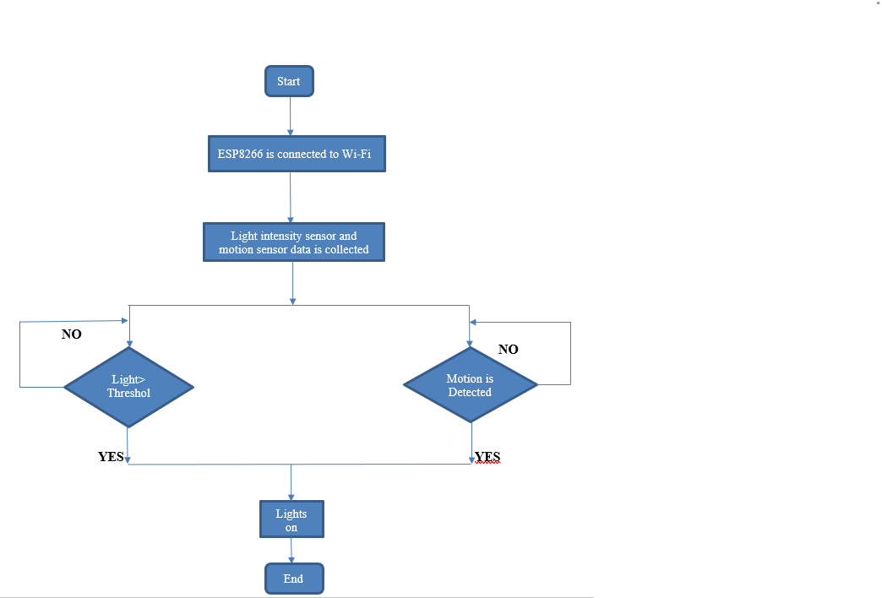

Slide 10
Algorithm
1. Interface Node MCU.
2. Initialize PIR sensors.
3. Initialize LDR sensor.
4. Capture motion by sensor.
5. Detect light intensity using LDR.
6. Sensor data is published via Esp8266 using Mqtt protocol over AWS cloud.
7. Node-Red will perform all the logical computations over cloud.
(i)if LDR value below threshold value, then turn on lights signal is generated.
(ii)if not then let the lights be off signal is generated.
8. Output of Node-Red is sent back to the subscribed NodeMCU as well as over database.
9. NodeMCU will convey the signal to connected relays which will trigger appliances.
10.Graphical representation will be depicted using database over GUI panel.

Slide 11

Proposed Methodology : Explanation
NodeMCU Microcontroller:- The NodeMCU is an open-source software and hardware development environment built around an inexpensive System-on-a-Chip (SoC) called the ESP8266. The microcontroller will be integrated with Wi-Fi module which will be connected to Node red through MQTT protocol on Cloud.
PIR sensor: - It detects a human being moving around within approximately 10m from the sensor. This is an average value, as the actual detection range is between 5m and 12m.
LDR sensor: - An LDR or light dependent resistor is also known as photo resistor, photocell, photo conductor. When the light falls on the resistor, then the resistance changes.

Slide 12
Proposed Methodology : Explanation
MQTT Broker:- An MQTT broker is a server that receives all messages from the clients and then routes the messages to the appropriate destination clients.
SQL Database:- SQL is Structured Query Language, which is a computer language for storing, manipulating and retrieving data stored in a relational database.
Node-Red:- Node RED is a programming tool for wiring together hardware devices, APIs and online services in new and interesting ways. It provides a browser-based editor that makes it easy to wire together flows using the wide range of nodes in the palette that can be deployed to its runtime in a single-click.
Relay:- Electromagnetic relays are those relay which operates on the principle of electromagnetic attraction. It is a type of a magnetic switch which uses the magnet for creating a magnetic field. The magnetic field then uses for opening and closing the switch and for performing the mechanical operation.

Slide 13
Advantages of Proposed System
Full control over all applications using a single device.
Improve energy efficiency of building.
Increase in convenience.

Slide 14
Applications
Can be used in places like household, institutions, industries, colleges.
Smart Parking, Lighting and Infrastructure.
Promotes Green buildings.
Energy conservation.

Slide 15
Conclusion and Future Scope
The goal of this project is to systematically review IoT enabled services in smart buildings. The conducted project shows that this is relatively recent research area, and, judging by the growing number of IOT applications, it is currently in its hype phase.
The real application of IoT in smart buildings services is still in its infancy phase, even in the buildings which are leaders in this area. However, the IoT potential has been recognized, and it is not hard to imagine the services reviewed in this paper to become normal in a near future.
Integration frameworks for IoT and related technologies, Interoperability between various kinds of devices and middleware systems in the smart buildings environment.

Slide 16
References
Olivier Debauche and Yahya Moussaoui, “Internet of Things Learning: A practical Case for Smart Building automation”. IEEE 2020.
Anirudh Ramasami and Surya Varanasi, “Smart Building Automation using Internet of Things”. IRJET 2019.
A. H. Buckman, M. Mayfield, and S. B. M. Beck, “What is a Smart Building?” Smart and Sustainable Built Environment, vol. 3, pp. 92-109,2014.

